Slide 1
Analog Electronics Workshop
IEEE SUTD

Slide 2
Agenda
Learn basics of analogue electronics
Build some cool circuits

Slide 3
Analogue Electronics
Most basic electronic components
Resistors
Capacitors
Inductors
Semiconductor devices
LEDs
Diodes
Transistors

Slide 4
Analogue Electronics – Why?
Complement you Arduino/ RPi projects
Cheaper components
A lot of projects you do with your Arduino can also be implemented with discrete circuits
Bad ass. Shows your prowess.

Slide 5
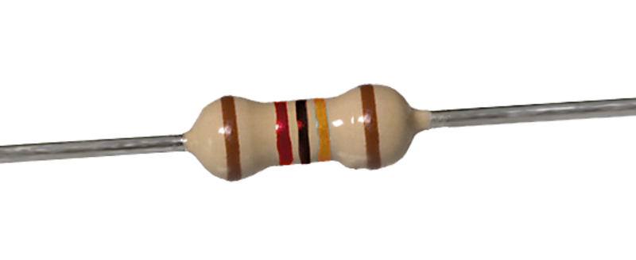
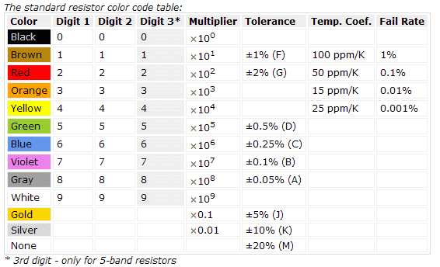
Resistors
Ideal resistors follow ohms law
V = I × R
Resists the flow of current
Units: Ω (ohms)
Symbol: R

Slide 6
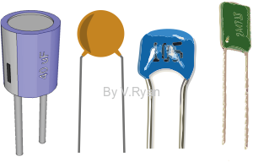

Capacitor
Charge on a capacitor is given by its capacitance and the voltage across it
Q = C × V >> I = C × $\frac{dV}{dt}$
Stores energy in an electric field
Units: F (Farads)
Symbol: C

Slide 7
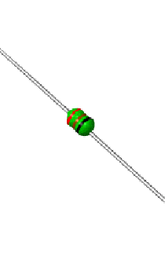

Inductor
V = L × $\frac{dI}{dt}$
Stores energy in a magnetic field
Units: H (Henry)

Slide 8
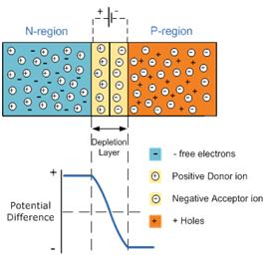
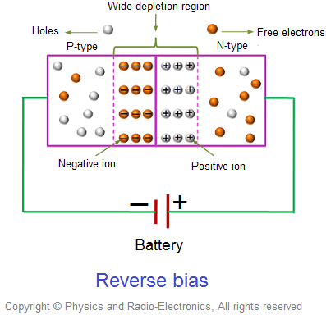
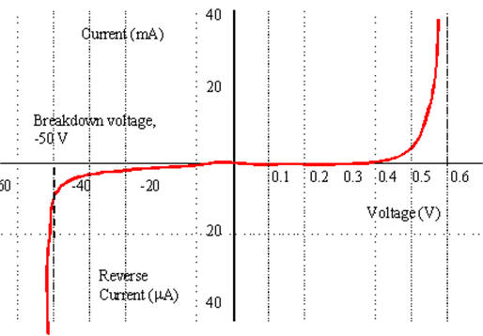
Diodes
Semiconductor device formed from a N and P doped semiconductor joined together.
Allow current to flow in one direction only.

Slide 9
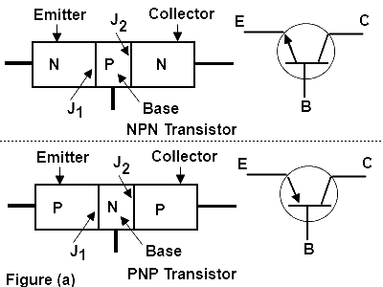
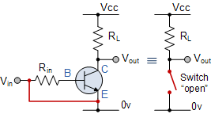
Transistors – BJTs
Formed from NPN junctions or PNP junctions. (Bipolar junction transistor)
Electronic switch
Can also be used as an amplifier
cv
cv

Slide 10
Transistors
As a switch
NPN:
If Vbe is > 0.7V
Transistor turns on
PNP
If Veb is > 0.7V
Transistor turns on
cv

Slide 11
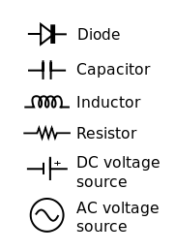
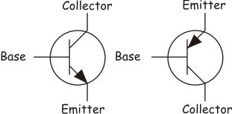
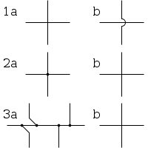
Schematic Symbols

Slide 12
Understanding Schematics

Slide 13
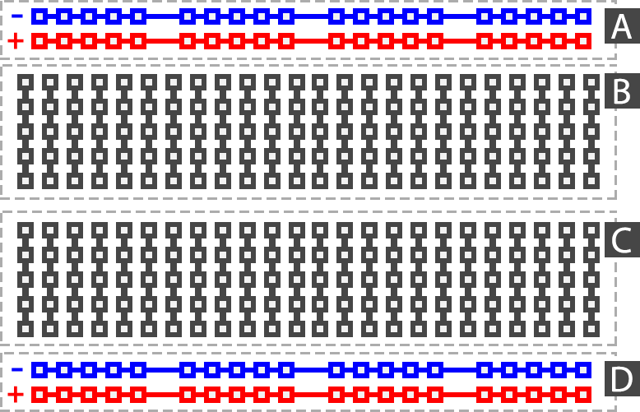
Building Circuits on a Breadboard

Slide 14
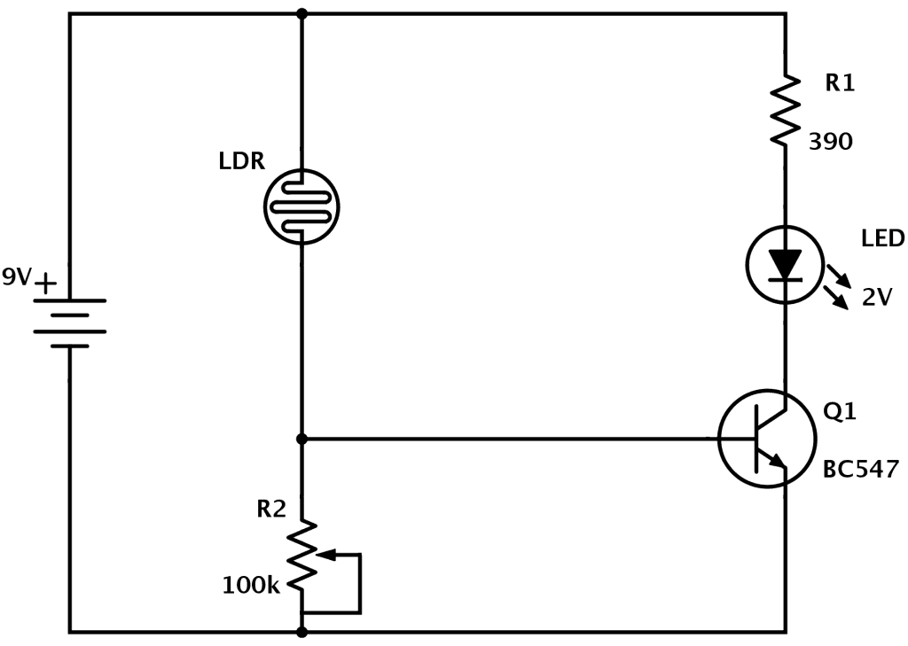
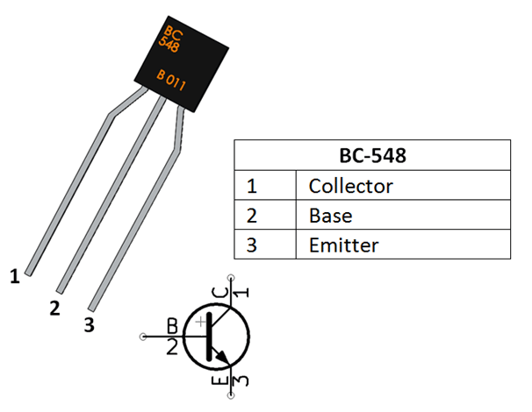
Circuit #1 Light Sensor
5V
10k

Slide 15
Circuit #1 Light Sensor
Can you …

Slide 16
Circuit #2 Burglar Alarm
Input: Burglar crosses beam of IR light
Triggers circuit
Output: Buzzer / LED turns on AND doesn’t turn off even after crossing
Latch output

Slide 17
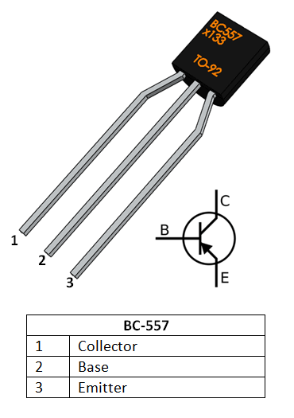
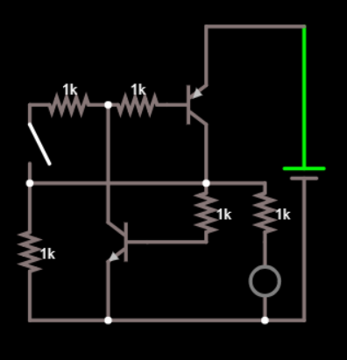
Circuit #2 Burglar Alarm

Slide 18
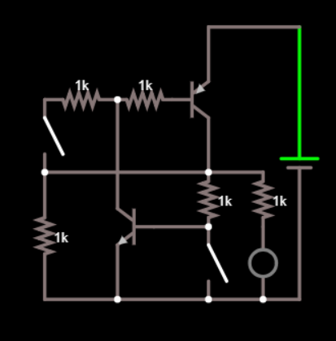
Circuit #2 Burglar Alarm

Slide 19
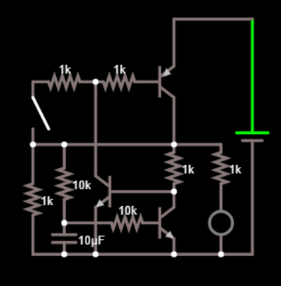
Circuit #2 Burglar Alarm

Slide 20
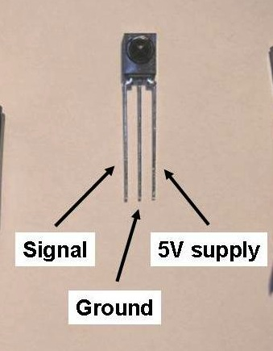
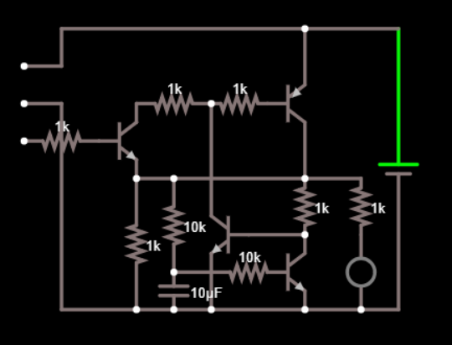
Circuit #2 Burglar Alarm

Slide 21
Thank you

